Slide 1
Introduction to coursework 1.1 and Use Case Analysis
Lecture 5

Slide 2
Requirements
Can be functional
What the system should do
e.g. provide a login facility that uses a username and password
Can be non-functional
Constrains on how the functions are provided
Username must be longer than six characters
Software must be written in Java

Slide 3
Use cases and user stories
In this module we will be focusing on the application of use cases for requirements analysis
User stories are less formal and simpler to define than use cases and are widely used in Agile development

Slide 4
User story
As a returning user, I want to log in using my username and password to access my account. The login page should display clear labels for username and password fields.
History Kent Beck 1997

Slide 5
Use cases (Jacobson 1986)
Use → How you use the system
Case → An example scenario
Functional modelling of requirements
Show the external view of the system
(Does not model internal processes)
Show the system relative to different users of the system
Users of the system are termed Actors

Slide 6
Use Cases
Use-Cases are a scenario based technique in the Unified Modeling Language (UML) which identify the actors in an interaction and which describe the interaction itself.
A set of use-cases should describe all possible interactions with the system.
Sequence diagrams may be used to add detail to use-cases by showing the sequence of event processing in the system (we shall study sequence diagrams later).

Slide 7
Use Cases
In a use-case diagram, an actor is a user of the system (i.e. Something external to the system; can be human or non-human) acting in a particular role.
A use-case is a task which the actor needs to perform with the help of the system, e.g., find details of a book or print a copy of a receipt in a bookshop.

Slide 8
Actors (players)
Anything external to the system which the system interacts with
Can be human
Customer
Player (game)
Driver
Can be non-human
Sensor (smoke detector)
Payment service (credit cards)
Geo location
Robotic arm
Email server

Slide 9
Use Cases
The details of each use case should also be documented by a use case description: E.g.,
Print receipt – A customer has paid for an item via a valid payment method. The till should print a receipt indicating the current date and time, the price, the payment type and the member of staff who dealt with the sale.
[Alternate Case] – No print paper available – Print out “Please enter new till paper” to the cashier’s terminal. Try to print again after 10 seconds.
An alternate case here is something that could potentially go wrong and denotes a different course of action.

Slide 10
Example - Article Printing Use-Case
Actor
Use case

Slide 11
ATM machine
Actors
Customers
Bank staff
ATM service engineer
Use cases
Withdraw cash
Check balance
Add cash to machine
Check security video recording

Slide 12
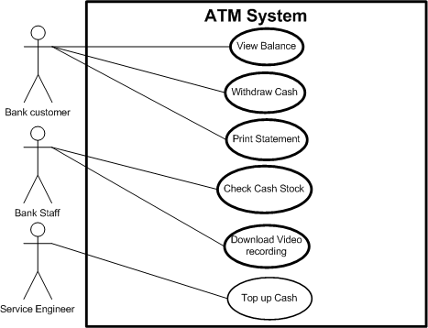
Example - ATM Use Case Diagram

Slide 13
Advanced Use Case Diagrams
We can draw a box (with a label) around a set of use cases to denote the system boundary, as on the previous slide (“ATM system”).
Inheritance can be used between actors to show that all use cases of one actor are available to the other:
Service Engineer
Bank Staff

Slide 14
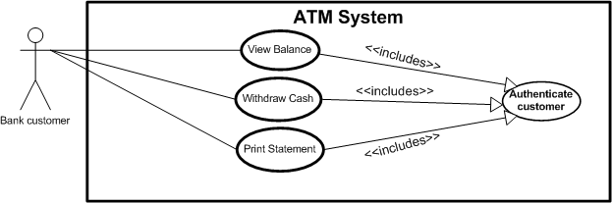
Include Relations
If several use cases include, as part of their functionality, another use case, we have a special way to show this in a use-case diagram with an <<include>> relation.

Slide 15
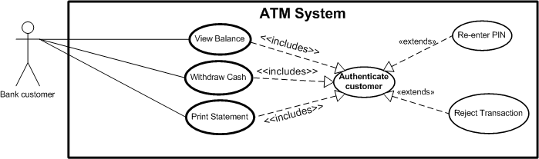
Extend Relations
If a use-case has two or more significantly different outcomes, we can show this by extending the use case to a main use case and one or more subsidiary cases.

Slide 16
In summary
Include
When the other use case is always part of the main use case
Extend
When the other use case, is needed as an optional outcome due to certain circumstances/scenarios

Slide 17
A Word on Extend/Include
Note the directions of the arrows in the previous two slides, they are different for each (according to whether a use case “includes” another, or “extends” it).
One of the benefits of UML diagrams is their simplicity and that they can be shown to and worked through with, customers.
This is to some extent lost by using more advanced features like “include” and “extend” relations; they should thus be used with care.

Slide 18
Full use case template
ID
Short ID (useful for diagrams and reference) Example UC1
Name
Full name Login
Description
Full description User login
Pre-condition
What must be true before the use case can proceed System is online
Event flow
Flow of behaviour that makes up this use case, can include other use cases user enters username + password, if credentials correct user is authenticated
Post-condition
Possible change of internal state (e.g. authenticated=true if username, password correct, user account locked if wrong password 3 times)
Includes
What other use cases are used
Extensions
Optional behaviour
Triggers
What makes this use case happen

Slide 19
Notes about use cases
They do NOT describe internal behaviour
Must describe behaviour with external Actors
But external Actor can be
External system (e.g. Paypal)
External hardware (e.g. smoke detector fire alarm)
External agency (e.g. Police, fire brigade)
So use cases are always involve external behaviour

Slide 20
ATM use case descriptions
ID | UC1
Name | Withdraw cash
Description | Bank customer withdraws cash from machine
Pre-condition | ATM in service
Pre-condition | ATM has sufficient cash stock
Event flow | 1. Include Use case 2 “Authenticate customer” 2. Choose quick cash or enter exact amount 3. Choose receipt option 4. Take cash
Extension points | Use case 4 “Balance too low”
Triggers | Withdraw cash button pressed
Post condition
Transaction added to account

Slide 21
ATM use cases
ID | UC2
Name | Authenticate customer
Description | Bank customer proves their identity to the ATM.
Pre-condition | ATM in service
Pre-condition | User not authenticated
Event flow | 1. If user already authenticated exit from user case. 2. User enters card and PIN number 3. User re-enters PIN if PIN incorrect
Extension points | Use case 5 “Card stolen” Use case 6 “PIN entry failure”
Triggers | Authenticated service requested
Post-condition | User is authenticated if credentials correct

Slide 22
ATM use cases
ID | UC3
Name | Check balance
Description | Bank customer retrieves a balance for their account
Pre-condition | ATM in service
Event flow | 1. Include Use case 2 “Authenticate customer” 2. Choose onscreen or paper balance
Extension points | None
Triggers | Check balanced requested
Post-condition | None

Slide 23
ATM use cases
ID | UC4
Name | Balance too low
Description | Bank customer cannot make cash withdrawal due to low balance
Pre-condition | None
Event flow | 1. Customer chooses smaller amount or cancels transaction
Extension points | None
Triggers | Cash chosen greater than available balance
Post-condition | None

Slide 24
Next lecture…
Please look at Hotel booking case study
Please prepare this case study problem..

